Slide 1


Social Buzz - Analysis
Notes:
Good morning, everyone, I’m Balaji working as a data analyst. I’m excited to be here to update everyone on the analysis of social buzz. Your inputs and insights are vital in this project, so I’m eager to hear your thoughts as we move forward.

Slide 2



Today's agenda
Project recap
Problem
The Analytics team
Process
Insights
Summary
Notes:
So before we get started let me quickly outline our agenda for today’s presentation. We’ll first take quick recap on our project, then we move on to the problem. And we’ll get to know the analytics team involved in this project. Then I’ll explain the process of analysis of social buzz’s data analysis. And everyone the best part comes after this; we’ll see all the insights gathered from data analysis by our analytics team. Then I’ll summarize the work done until now. And finally, I’ll get questions from everyone.

Slide 3

Project Recap
Social Buzz is a fast-growing tech Unicorn which needs to adapt quickly to its global scale.
Accenture has begun its three-month POC focusing on these tasks:
An audit of their big data practice
Recommendations for a successful IPO
Analysis to find the top 5 most popular content categories

Slide 4

Problem
Over 1,00,000 pieces of content with multiples unstructured data types per day.
3,65,00,000 pieces of content per year!
But to capitalize on it when there is so much?
Analysis to find the top 5 most popular content categories

Slide 5




Andrew Fleming
Chief Technical Architect
The Analytics team
Marcus Rompton
Senior Principle
Balaji C R
Data Analyst

Slide 6

Process
1
Data Understanding
2
Data Cleaning
3
Data Modelling
4
Data Analysis
5
Uncover Insights

Slide 7
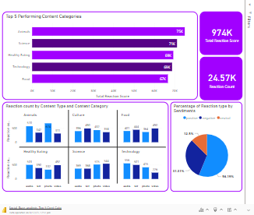
Top-performing content categories for maximum user engagement
Almost all the content categories and content types have similar percentage of sentiment distribution.
56.2% of reaction types are considered as positive reaction, 32.1% is negative reaction and 12.5% is neutral reaction.
Dashboard link

Slide 8
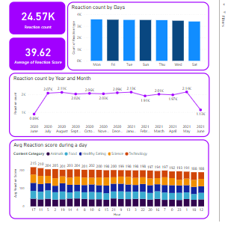
Ignite user engagement with strategic content release
January, May and August counts more reactions from the users than other months for the top 5 content categories.
The number of reactions from the user and the average score for each content category during a day and the week is similar for the top 5 content categories.
Dashboard link

Slide 9


Create more content on Healthy Eating, Animals, and Science to engage users. Create specific types of contents for each category to maximize user engagement.
Summary
Using the insights Social Buzz can optimize the timing of the content release to increase engagement, leads to platform growth.

Slide 10
Thank you!
ANY QUESTIONS?

